Slide 1
Drivetrains

Slide 2
What is a drive train?
The drivetrain is, by definition, is the system in a motor vehicle that connects the transmission to the drive axles. Its purpose is to move the robot around the field, push/pull objects, and climb up ramps or over/around obstacles. It is the most important sub-system since without mobility, it is impossible to score or prevent points. The drivetrain must be durable and reliable to be successful and its important abilities are speed, pushing force, and agility. The basic components of it are the frame, wheels, gearboxes, and chain.

Slide 3
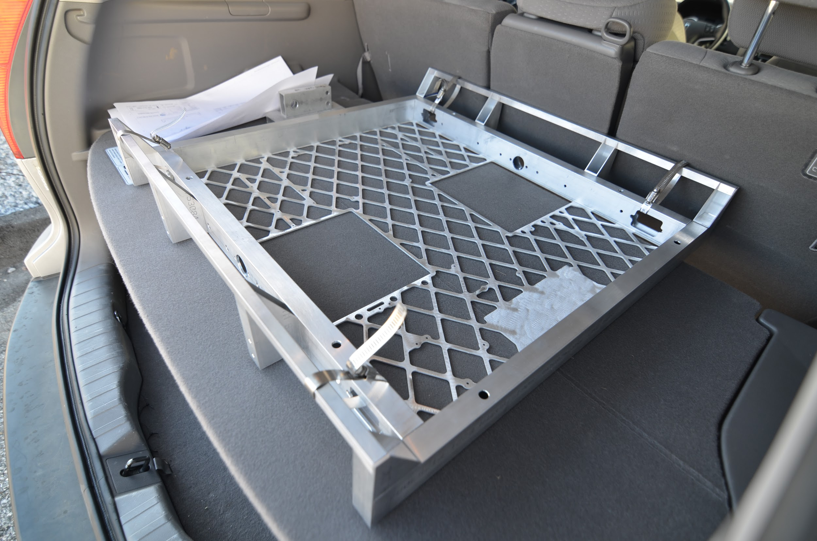
Frame
The base
The drivetrain without to wiring, gearboxes, wheels and such

Slide 4
Wheels

Slide 5
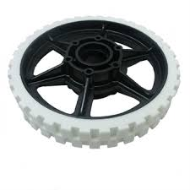
Traction
Standard wheels
Varying amounts of traction, strength, and weight

Slide 6
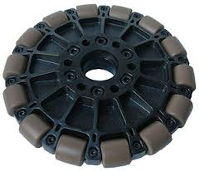
Omni
Rollers attached to circumference
Perpendicular to the axis of rotation of the wheel
Allows for omni directional motion

Slide 7
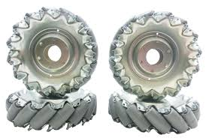
Mecanum
Rollers attached to circumference
45 degree angle to the axis of rotation of the wheel
Allows for omni directional motion
.

Slide 8
Gearboxes

Slide 9
What are gearboxes
A gearbox is a set of gears within a casing that increases torque while reducing speed from the motor. The selection of what gears go inside the gearbox is based on gear ratios. A gear ratio is the relationship between the numbers teeth on two meshed gears, and it's represented as a ratio. If a gear with a large circumference is turning one that is only half as big, the smaller gear will spin twice as fast as the larger one

Slide 10
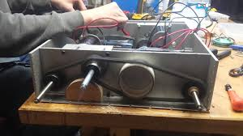
Chain
Rotates axles attached to gear boxes which in turn rotates wheels

Slide 11
Types of Drivetrains

Slide 12
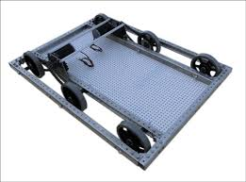
Tank
Left and right wheel(s) are driven independently
Typically in sets of 2
Strengths: simple & cheap to design, build, and program; easy to drive; potential for high speed and/or pushing force
Weaknesses: slightly less agile than other drivetrains

Slide 13
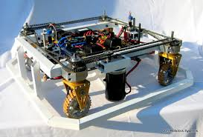
Swerve
Wheels modules rotate on the vertical axis to control direction
Typically 4 traction wheels
Strengths: Has potential for high speed and/or pushing force; agile
Weaknesses: Very complex and expensive to design, build, and program; extra motors required to be able to rotate robot frame

Slide 14
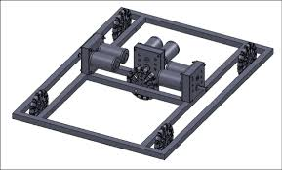
Slide
Similar layout to tank drive, with an wheel(s) perpendicular to the rest
Must use all omni wheels
Strengths: fairly easy and cheap to design, build, and program; agile
Weaknesses: no potential for high pushing force; extra wheel(s), motor(s), gearbox(es) required to allow robot translate sideways

Slide 15
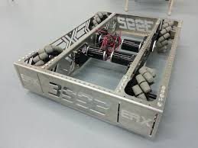
Mecanum
Similar layout to tank drive, but each wheel must be driven independently
Must use 4 mecanum wheels
Strengths: fairly easy to design and build; agile
Weaknesses: no potential for high pushing force; challenging to program and learn to drive well; requires extra gearboxes; wheels are expensive

Slide 16
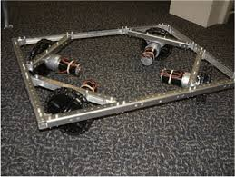
Holonomic
4 omni wheels positioned on 45 degree angles in the corners of the frame
Each wheel must be driven independently
Strengths: agile
Weaknesses: no potential for high pushing force; very challenging to program and learn to drive well; requires extra gearboxes

